Slide 1
Marketing

Slide 2
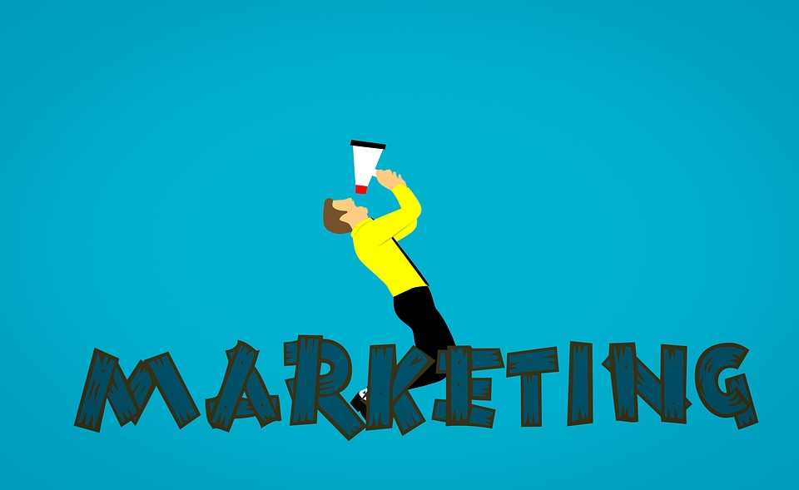
What is

Slide 3
What is marketing
The process by which companies create value for customers and build strong customer relationships in order to capture value from customers in return.
Kotler and Armstrong (2010).
Marketing is a function of the organization and a set of processes to create, communicate and deliver value to customers, and to manage relationships with customers, in a way that benefits the entire organization

Slide 4
What is Marketing?
"Marketing consists of all the activities of individuals and organizations designed to identify, anticipate, and mutually satisfy the needs of all parties involved in the exchange."

Slide 5
Marketing
MARKETING:
The total of activities involved in the transfer of goods or services from the producer or seller to the consumer or buyer, including advertising, shipping, storing, and selling.
Marketing is typically seen as the task of creating, promoting and delivering differentiated goods and services to consumers and businesses at a profit

Slide 6
Whan can we market
Places
Properties
Organizations
Goods
Services
Experiences
Information
Ideas
Events
Persons

Slide 7
Marketing Mix Product
Brand name
Functionality
Personality
Positioning
Range
Looks

Slide 8
Marketing Mix
What are the 4 P’s?
Product / Value proposition / Consumer wants and needs
Price / Cost to satisfy
Place/ Distribution channels
Promotion/ communications / advertising

Slide 9
Product -
This variable described all factors relating to the actual product visible to the consumer. These may include things such as quality, features, options, style, packaging, brand, sizes, labels, variety, and warranties.

Slide 10
Price -
The price variable includes not only the list price, but all other pricing factors associated with a product.
These may include discounts,, payment options and periods, and credit terms.
All of these are related to the final, whole price of the product.

Slide 11
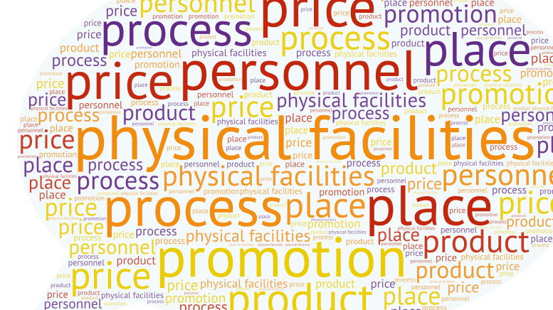
Place -
Place deals with all distribution and location aspects of a product. How and what are the products available to consumers? These may include assortments, channels, coverage areas, locations, and inventories.

Slide 12
Promotion -
Promotion is any and all efforts by a company to make publicize a product and make the consumer aware of it.
Efforts might include advertising, personal selling, sales, public relations, or internet an digital activities

Slide 13
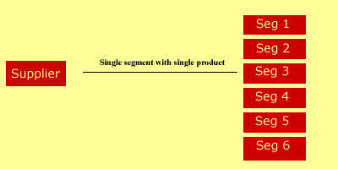
Market Segmentation
Market segmentation is the act of subdividing the market into a group or groups of people who have similar needs within the group, but dissimilar needs across the groups.
An example would be people wanting cars, but different types of cars. The different types of cars may be luxury, sports , or SUV's.

Slide 14
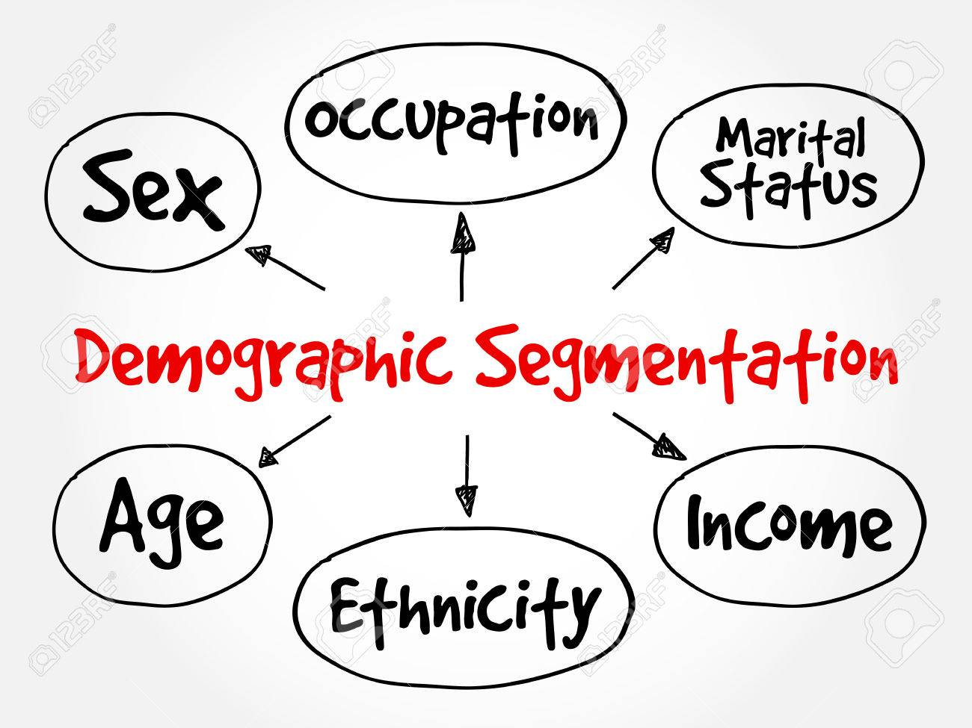
Marketing segmentation
There are 4 types of Market segmentation which are most commonly used.
1) Demographic segmentation
Demographic segmentation is one of the simplest and most widest type of market segmentation used. Most companies use it to get the right population in using their products.
Age, gender, family size, income, occupation, religion, race and nationality.

Slide 15
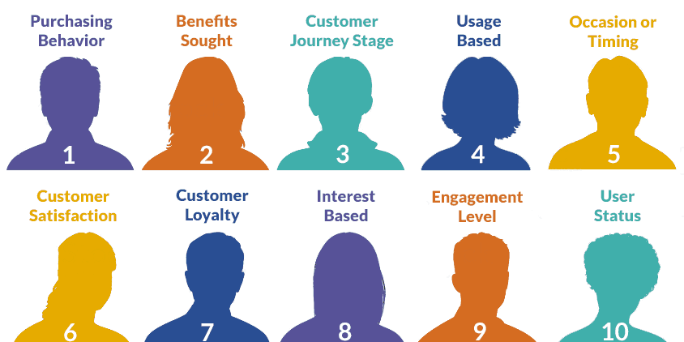
Marketing segmentation
2) Behavioral segmentation
This type of market segmentation divides the population on the basis of their behavior, usage and decision making pattern.
This type of market segmentation is in boom especially in the smart phone market. For example – Blackberry was launched for users who were business people, Samsung was launched for users who like android and like various applications for a free price, and Apple was launched for the premium customers who want to be a part of a unique and popular niche.

Slide 16
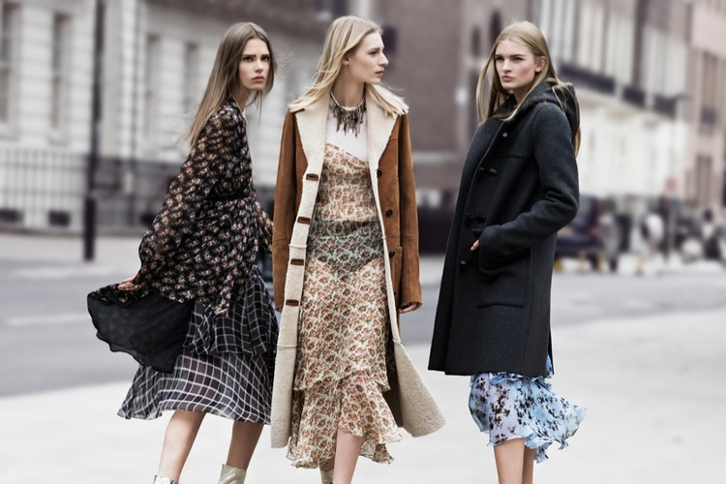
Marketing segmentation
3) Psychographic segmentation
Psychographic segmentation is one which uses lifestyle of people, their activities, interests as well as opinions to define a market segment. Psychographic segmentation is quite similar to behavioral segmentation. But psychographic segmentation also takes the psychological aspects of consumer buying behavior into accounts.
These psychological aspects may be consumers lifestyle, his social standing as well as his AIO. Do refer more to Activities, interests and opinions.
For example – Zara markets itself on the basis of lifestyle, where customers who want the latest and differential clothing can visit the Zara stores.

Slide 17
Marketing segmentation
4) Geographic segmentation
This type of market segmentation divides people on the basis of geography. Your potential customers will have different needs based on the geography they are located in.
Geographic segmentation principles are used when you are expanding the business in more local areas as well as international territories.

Slide 18
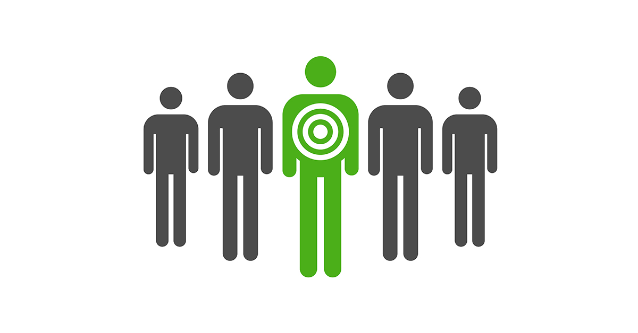
Targeting
Targeting is the second stage of the SEGMENT “Target” POSITION (STP) process.
After the market has been separated into its segments, the marketer will select a segment or series of segments and ‘target’ it/them.
Resources and effort will be targeted at the segment.

Slide 19
Targeting
The marketing mix should only be determined after a target market is determined.
Target market = The group or groups of customers for which the marketer will direct attention. This group is determined after thorough segmentation and analysis of the market.

Slide 20
External Factors (Uncontrollable)
Demographic environment - The features of a country that can be statistically described
Economic environment - The financial and economic conditions in a country will determine demand for any and all products.
Competitive environment - The intensity of competition in the market the business is in cannot be controlled.
Physical environment - Availability, use, and disposal of natural resources

Slide 21
External Factors (Uncontrollable)
Technological environment - Determines how the marketing should be done. What medium should be used?
Political and legal environment - Laws and restrictions may be set by various government agencies in regard to competition, consumer protection, or societal welfare.
Social/Cultural environment - What is acceptable in what culture may not be acceptable in another.
Company related environment - Goals and objectives of the company as a whole

Slide 22
Digital Marketing
Digital marketing encompasses all marketing efforts that use an electronic device or the internet. Businesses leverage digital channels such as search engines, social media, email, and their websites to connect with current and prospective customers.

Slide 23
Digital marketing
Digital marketing, the promotion of products or brands via one or more forms of electronic media, differs from traditional marketing in that it uses multiple channels and methods that enable an organization to analyze marketing campaigns and understand what is working and what isn’t – typically in real time.

Slide 24
Marketing Trends
1) Artificial Intelligence
2) Programmatic Advertising: Programmatic advertising means using AI to automate ad buying so you can target more specific audiences
3) Chatbots
4) Personalization: If you want to stand out in 2019, you need to personalize your marketing – and that means personalized content, products, emails, and more.
5) Video Marketing
6) Influencer Marketing

